Slide 1

Expected Time of Arrival and Occupancy Information

Slide 2
Abstract
In Expected Time of Arrival (ETA) and Occupancy Information, a SCADA system can be used to provide real-time data on the ETA of people or groups of people and the occupancy levels of a particular space or city.
Slot sensors and IR sensors can be used as sensors for ETA and occupancy data.
The central control unit processes and analyses the data that the sensors have collected to deliver real-time information.

Slide 3
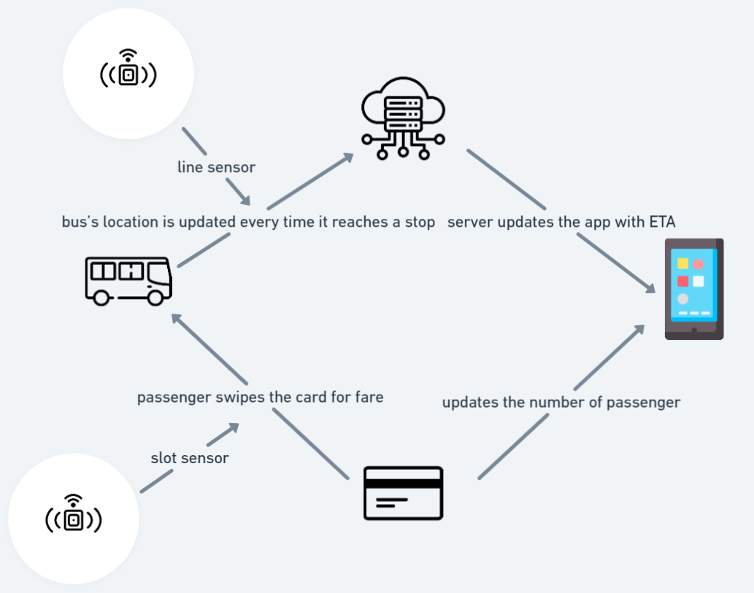
Model Overview

Slide 4
How it works?
The ETA and Occupancy Information is designed to provide real-time information about the expected arrival time of vehicles and the occupancy status of parking spaces in a given area.
This system uses sensors such as slot and various communication technologies and transmission protocols to collect and disseminate information to users.
When the vehicle arrives at the first stop,that message is sent to the user's phone using the sensors and messages are updates when the vehicle goes onto the next stop.
When the vehicle is late, a message stating the delay is sent to the user.

Slide 5
Communication Protocol
Data Distribution Service (DDS):
The protocol is used for everything from managing small devices to connecting high performance networks. DDS simplifies deployment, improves reliability and reduces complexity
MQTT:
A lightweight messaging protocol that may be used for communication between the ESP32 board and the cloud server.

Slide 6
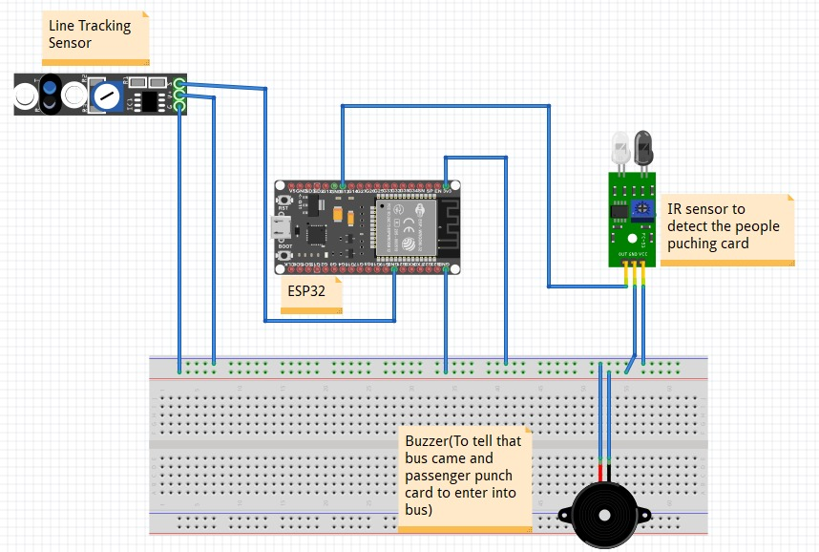
Circuit Design

Slide 7
Hardware components
Slot Sensor
breadboard
esp32
Jumper wires
Connectivity Wire
led
IR sensor

Slide 8
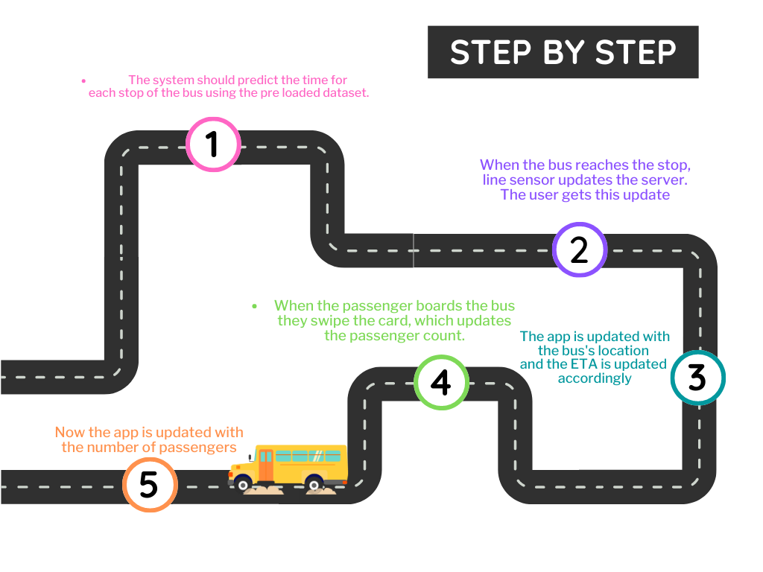
FlowChart

Slide 9

Cloud
Cloud computing lends itself more naturally to applications where large amounts of data need to be processed at once.
Cloud saves the data of all previous iterations
Clouds are places where data can be stored or applications can run. They are software-defined environments created by datacenters or server farms.
The cloud offers businesses more flexibility overall versus hosting on a local server.
Extra bandwidth, a cloud-based service can meet that demand instantly

Slide 10
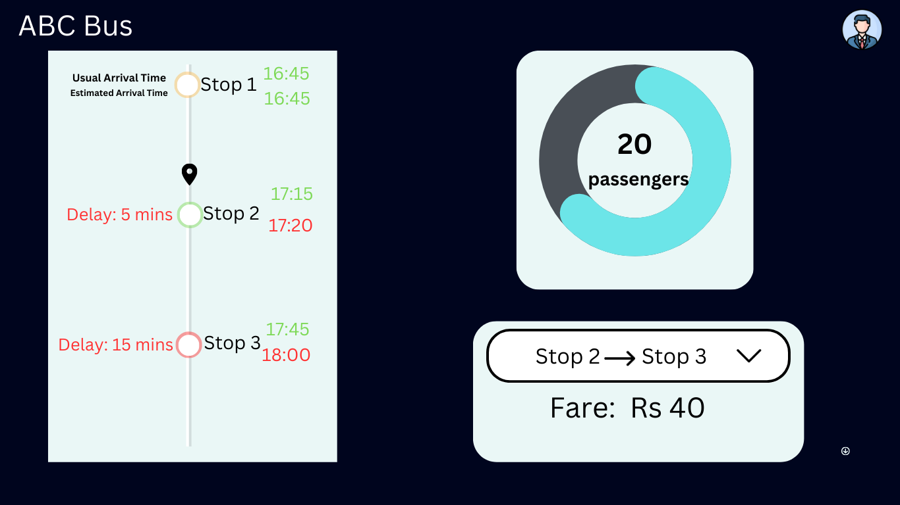
UI design

Slide 11
Deployment level
At Level 3, advanced analytics and automation capabilities come into play. In addition to collecting and processing data, IoT devices can perform more complex tasks, such as real-time data analysis, predictive modeling. This level of deployment enables more accurate and adaptive ETA calculations.
The system can automatically adjust the ETA based on real-time events and provide more reliable and up-to-date information to passengers. The actual deployment level for ETA of buses may vary depending on the specific implementation and the technology used by the transportation system. Some systems may have more advanced capabilities, while others may provide more basic ETA calculations.

Slide 12
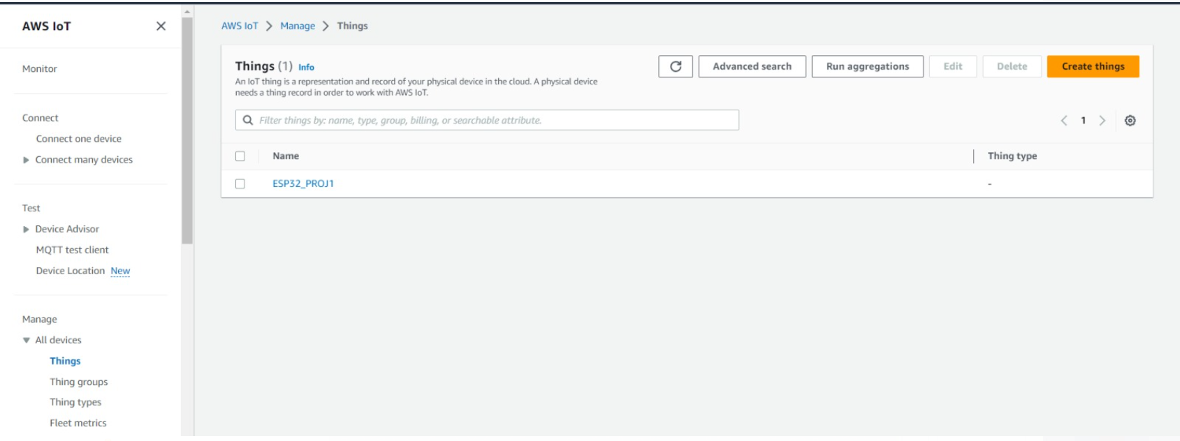
Things

Slide 13
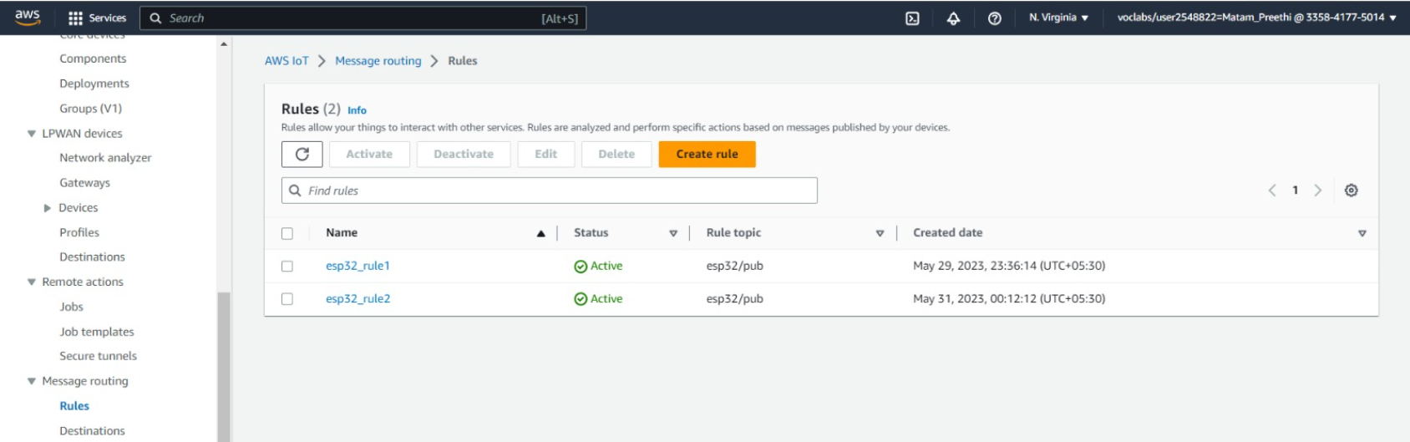
Rules

Slide 14
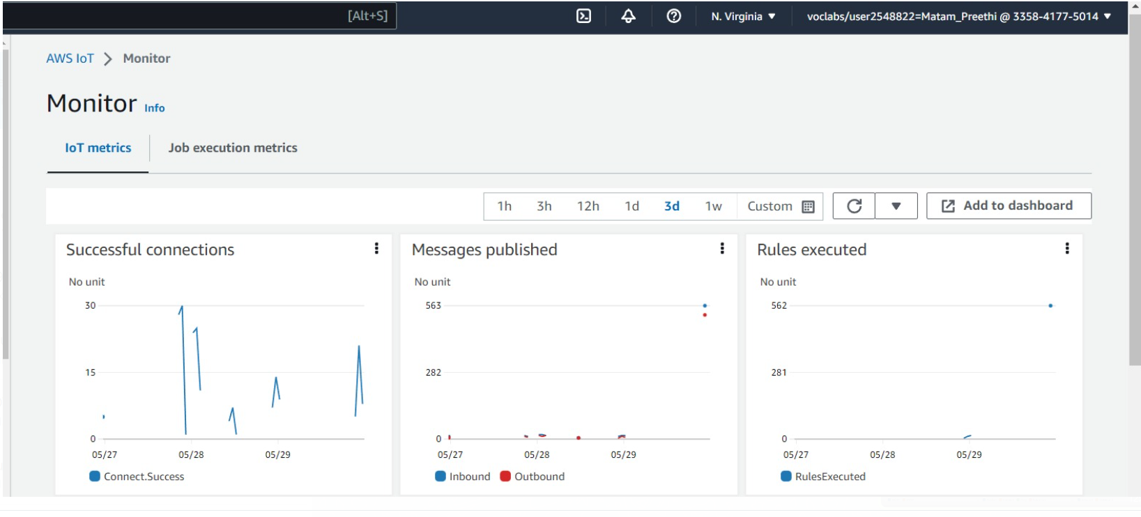
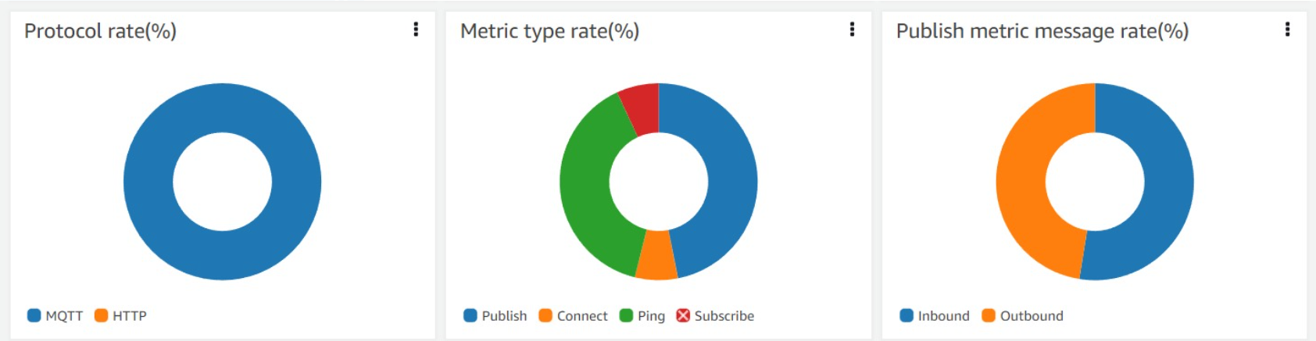

Slide 15
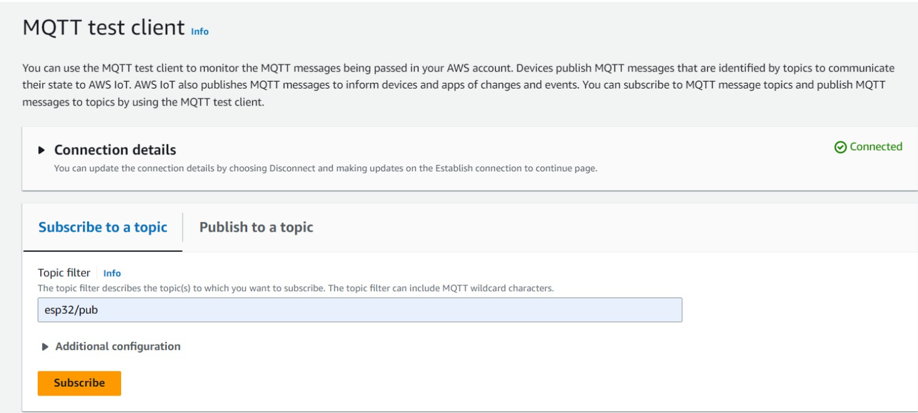

Slide 16
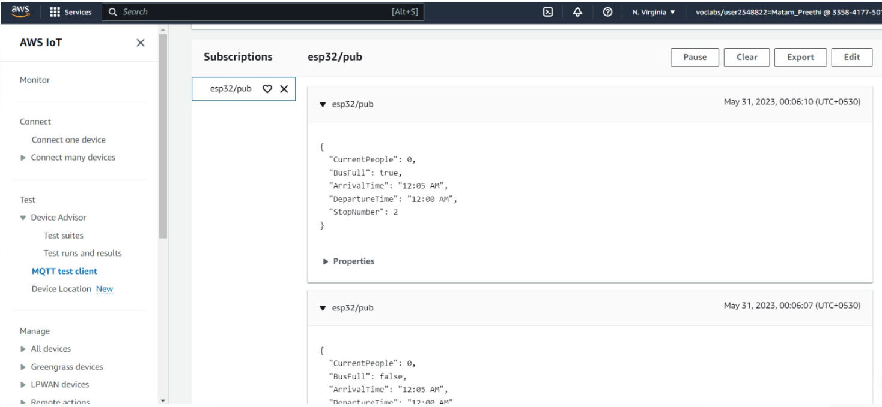
AWS

Slide 17
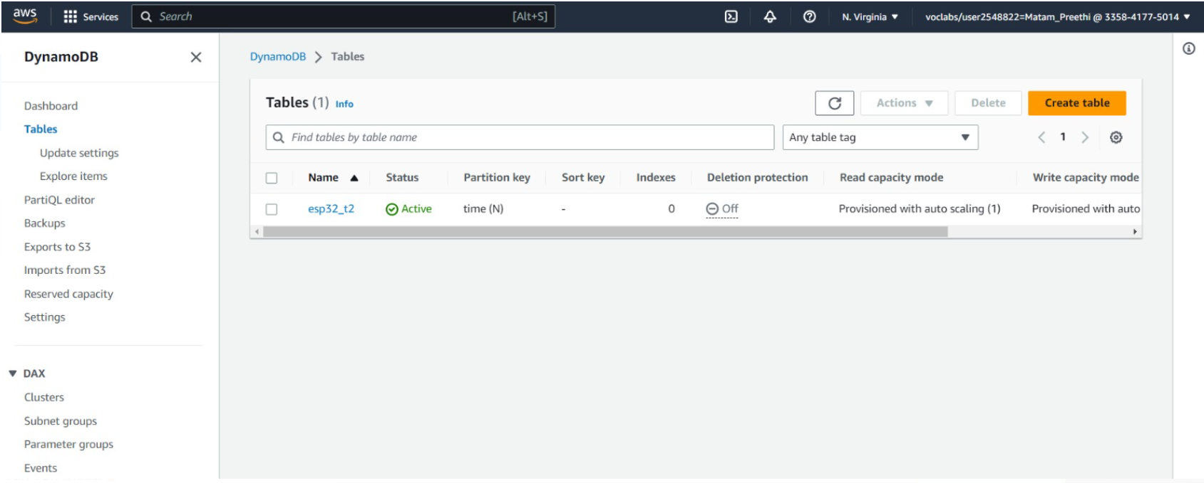
DynamoDB

Slide 18
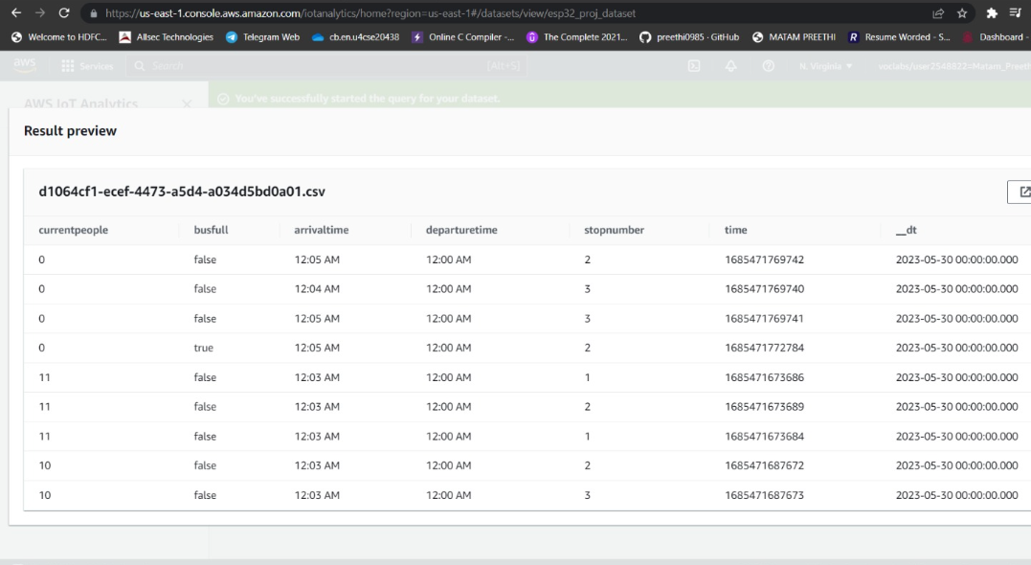
Data set and analytics

Slide 19
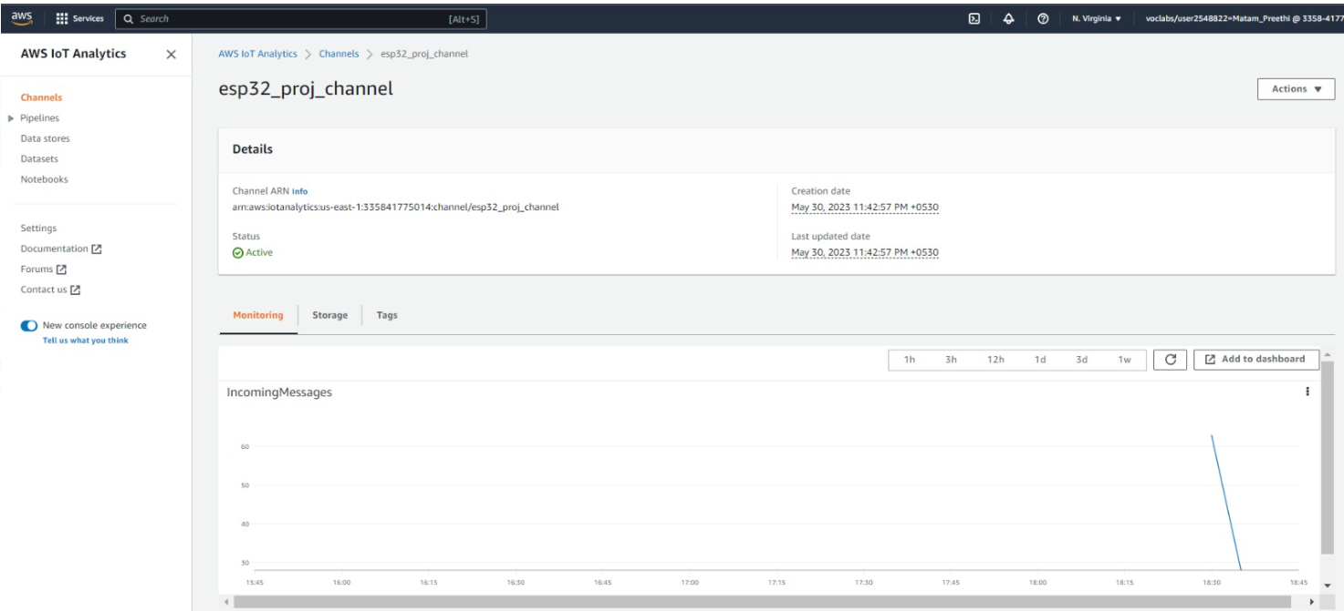
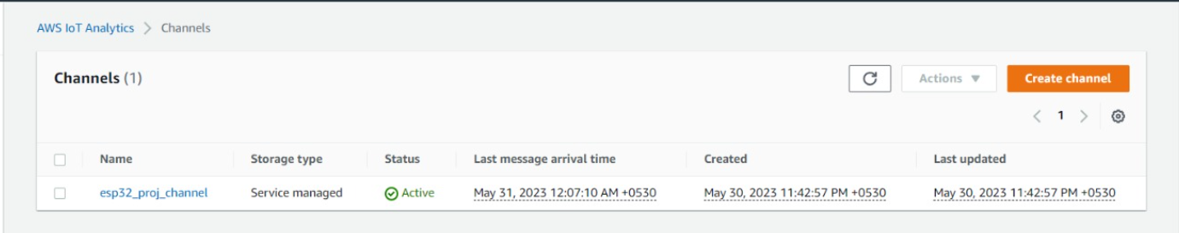
Overall and AWS analysis

Slide 20

Machine Learning

Slide 21
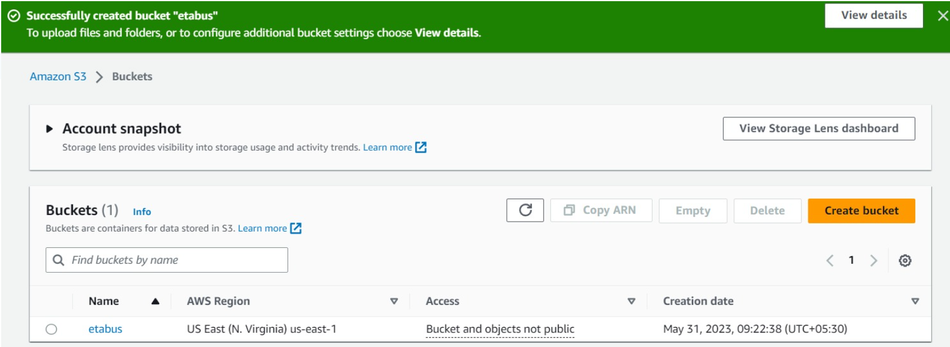
Bucket Creation

Slide 22
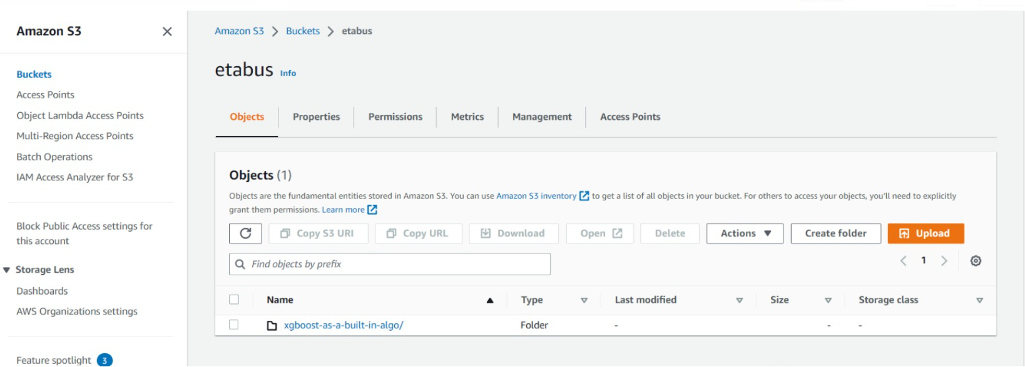
Object creation

Slide 23
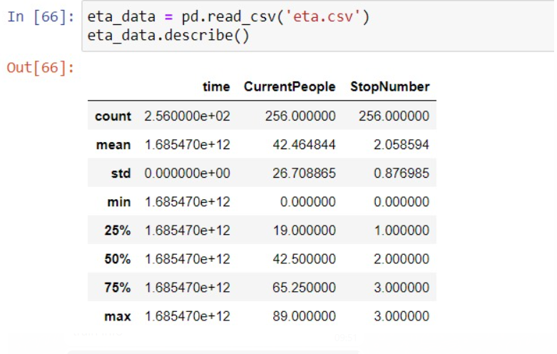
Data description

Slide 24
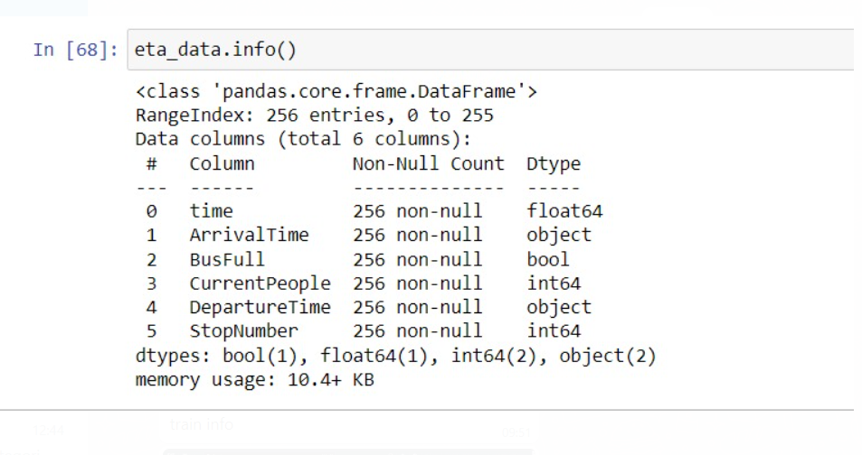
Data information

Slide 25
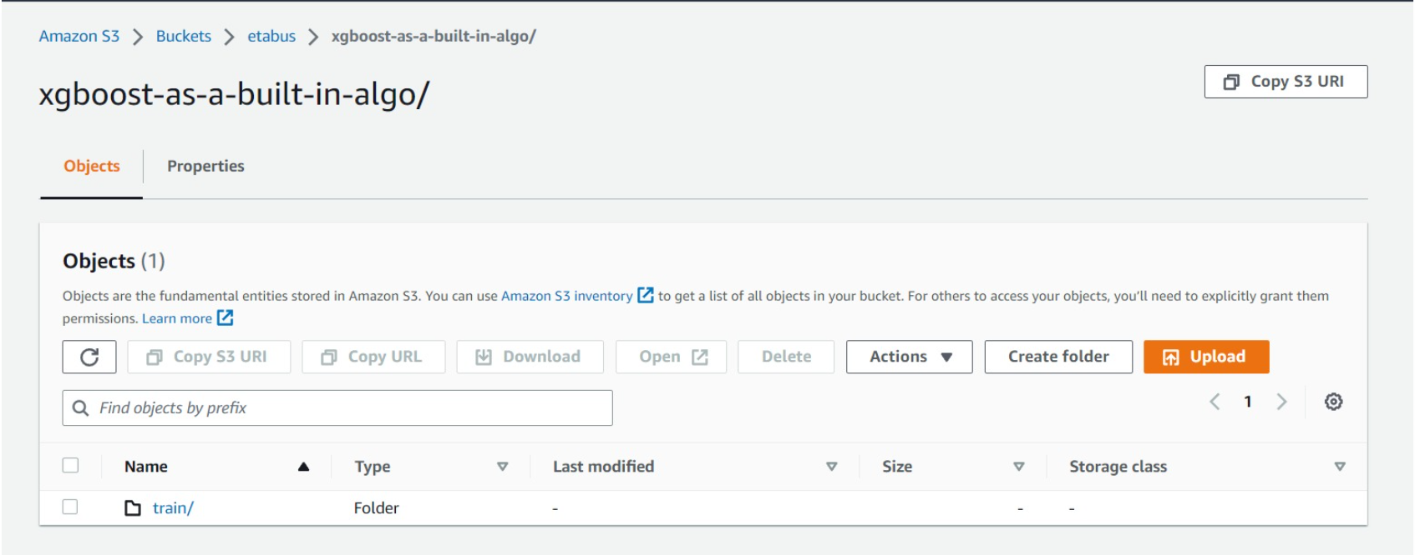
Train data

Slide 26
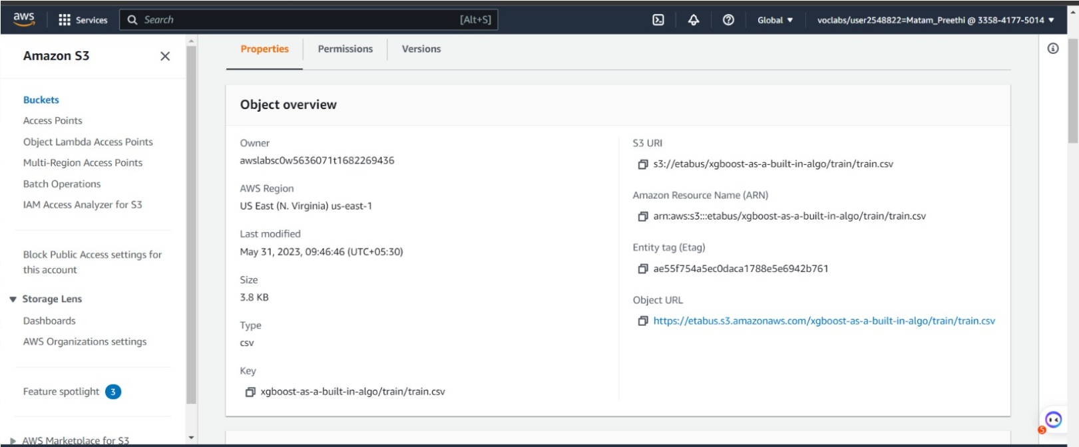
Train information

Slide 27
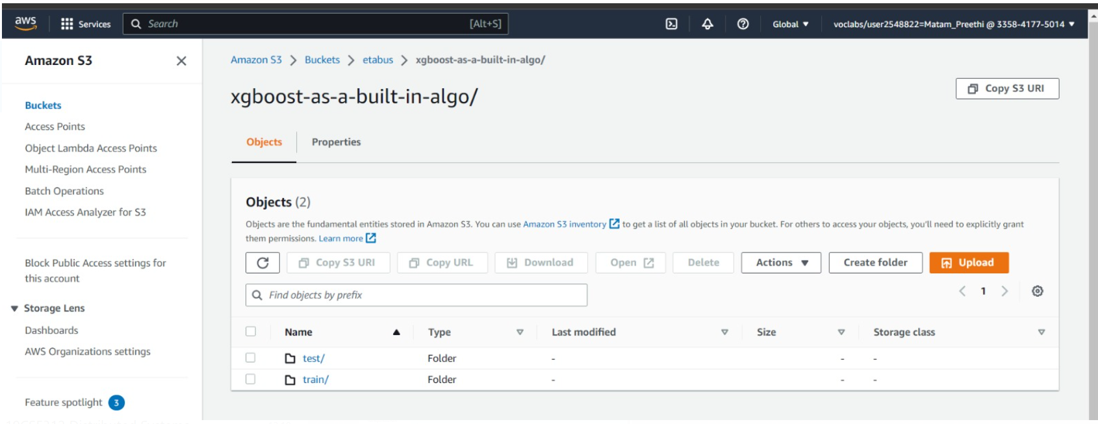
Test and train

Slide 28
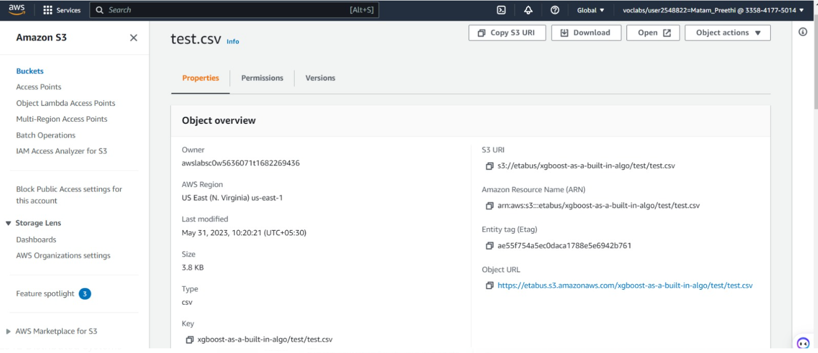
Test information

Slide 29
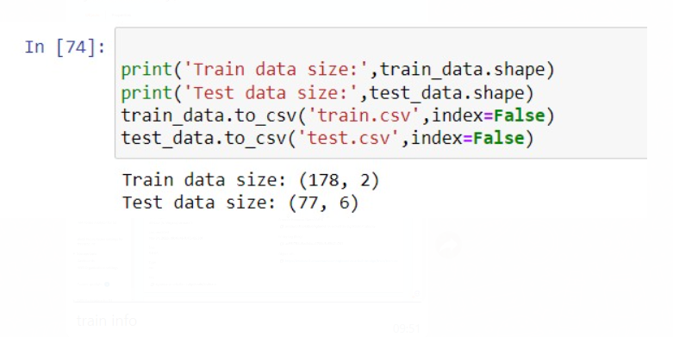
Test and train data

Slide 30
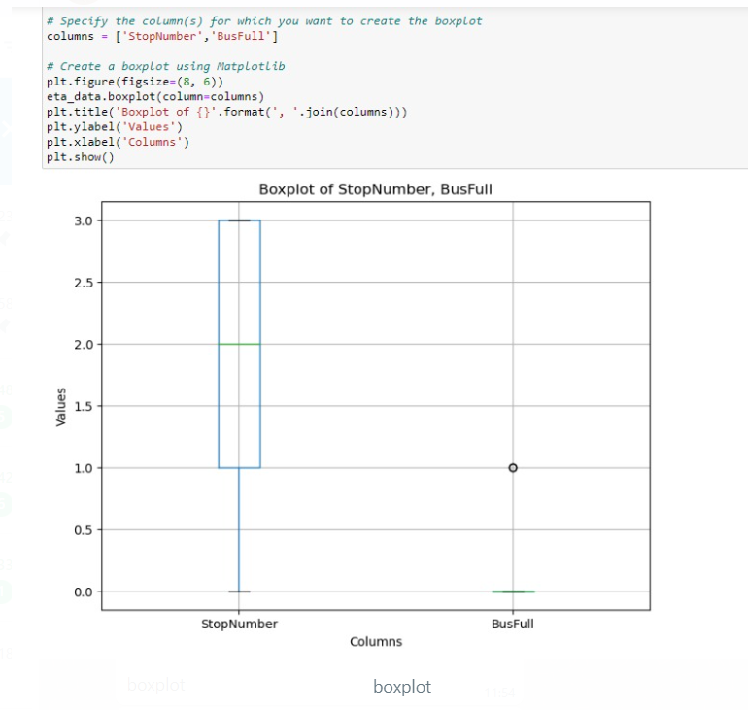
Box plot

Slide 31
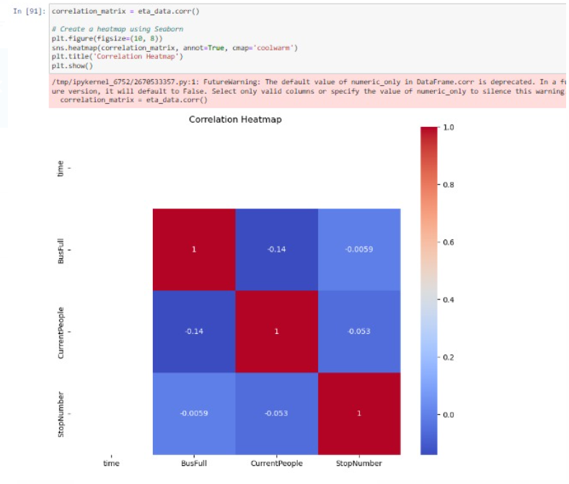
Heat map

Slide 32
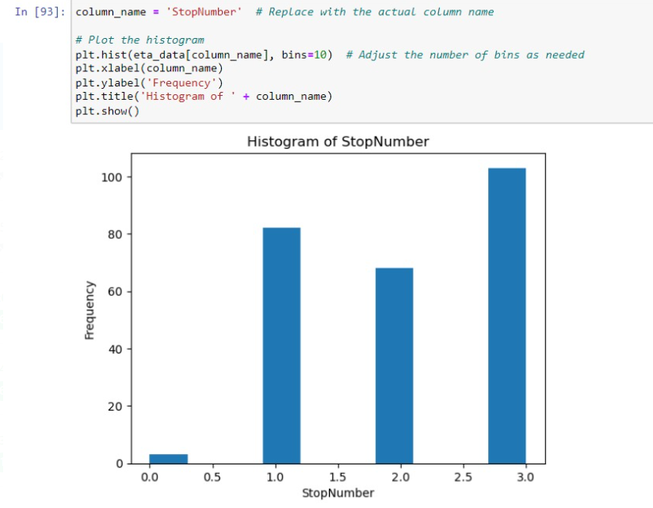
Heat map

Slide 33
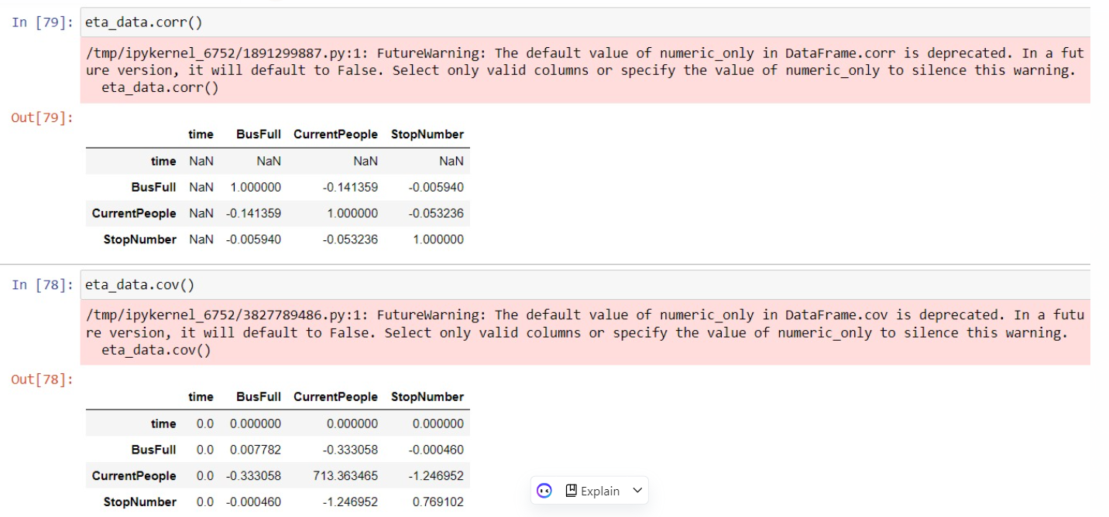
Correlation and covariance

Slide 34
About GreenGrass
Enables devices to collect and analyze data closer to the source of information,
React autonomously to local events,
Communicate securely with each other on local networks.

Slide 35
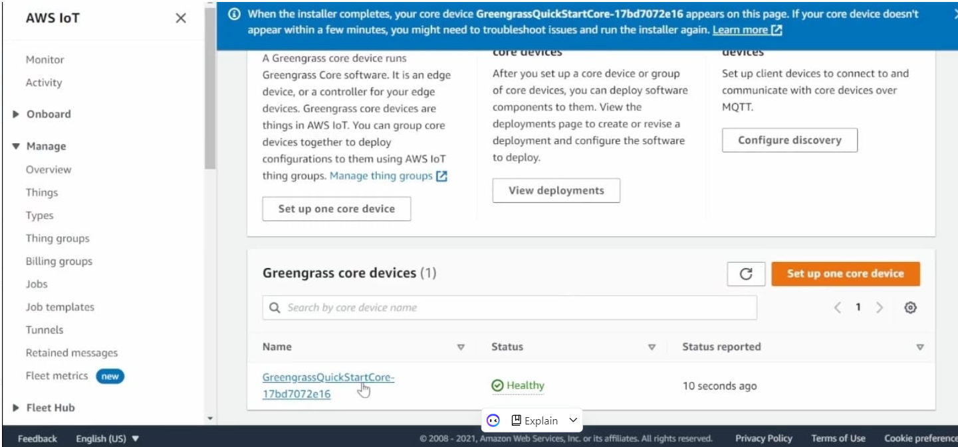
Creation

Slide 36
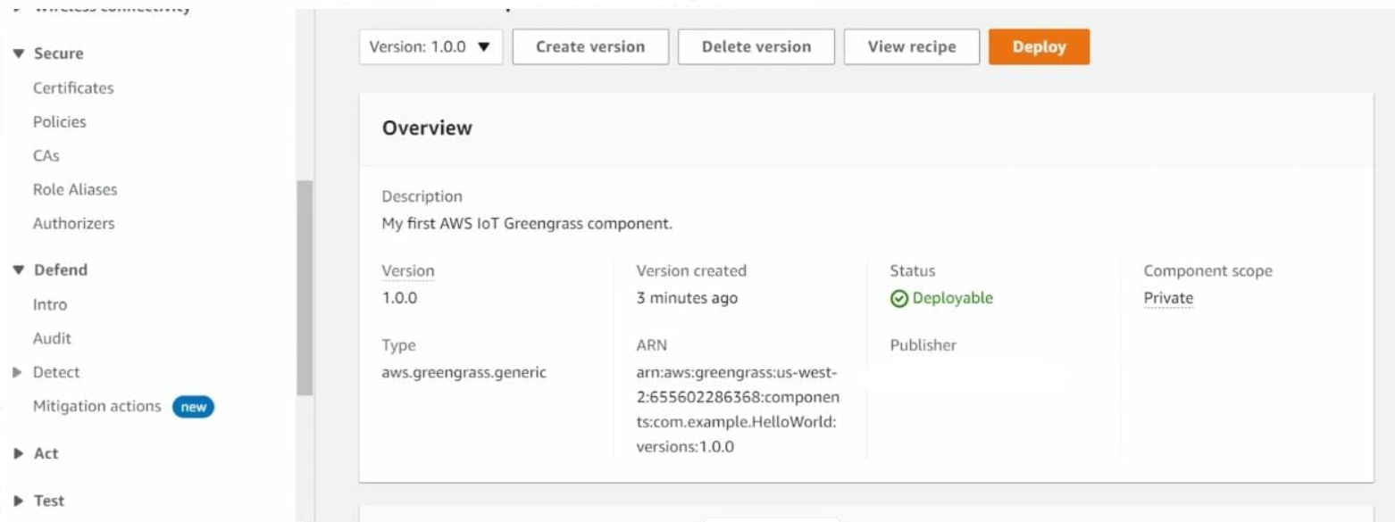

Slide 37

THANK YOU

